Slide 1
Distill-Phys: Knowledge Distillation for Robust Physiological Affect Recognition
Muhammad Abdullah, Kainat Arshad, Abdul Raziq
Supervisor: Sarun Varghese

Slide 2
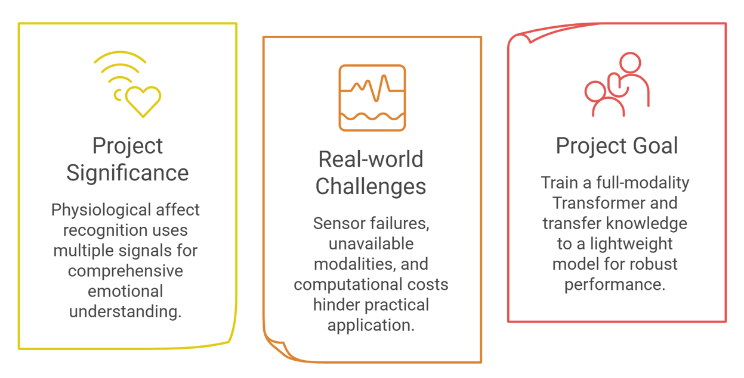
Project Motivation

Slide 3
Data Preprocessing
Preprocess BPM, ECG, respiration streams
Segment into 3 sec non-overlapping windows
Aggregate per window (mean, median, mode)
Normalise train-set only; assign arousal class
INPUTS → OUTPUT
BPM.csv
ECG.csv
Merge on
timestamp
3-sec
windows
resp.csv
EDA label
Output: train / devel / test CSVs · 28 columns each
6,926
Total windows
69
Subjects
28
Columns/window
3 sec = 6 rows
Window length
~0%
Missing values

Slide 4
Pre-processing pipeline
Load & merge
BPM·ECG·resp + label
Windowing
3 sec = 6 rows
Aggregation
mean·median·mode
Normalise
Z-score (train μ,σ)
Label assign
Low / Med / High
Stage 1-2
Merge 3 signals + label on timestamp
Window = 6 rows, hop = 6 (no overlap)
No leakage between windows
Stage 3-4
Per window: mean, median, mode
Z-score from train-only μ, σ
Raw + _norm columns both kept
Stage 5
Tertile split on train label_mean
Low 33% · Medium 33% · High 34%
Refs: Wiem & Lachiri 2017; Sanchez-Reolid 2022

Slide 5
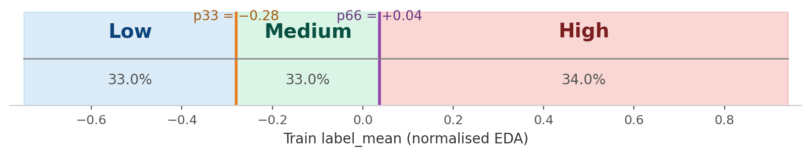
Design Decisions
Why 3-second windows?
Why non-overlapping?
Arousal changes over seconds, not ms
6 rows → stable per-window statistics
No redundant or duplicated rows
Prevents window-to-window leakage
Why train-only normalisation?
Why tertile (not fixed split)?
Z-score from train μ, σ only
Avoids leaking devel/test info
Labels are continuous & normalised
Data-driven → ~balanced 3 classes

Slide 6
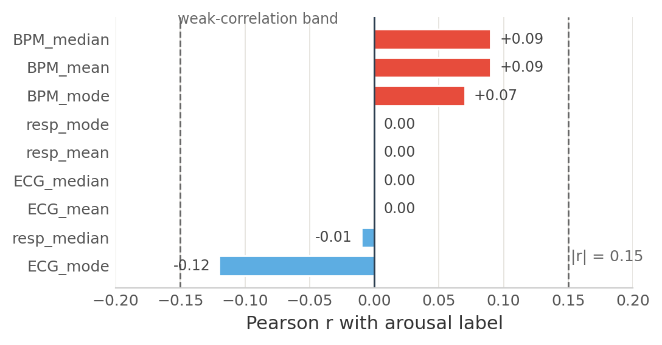
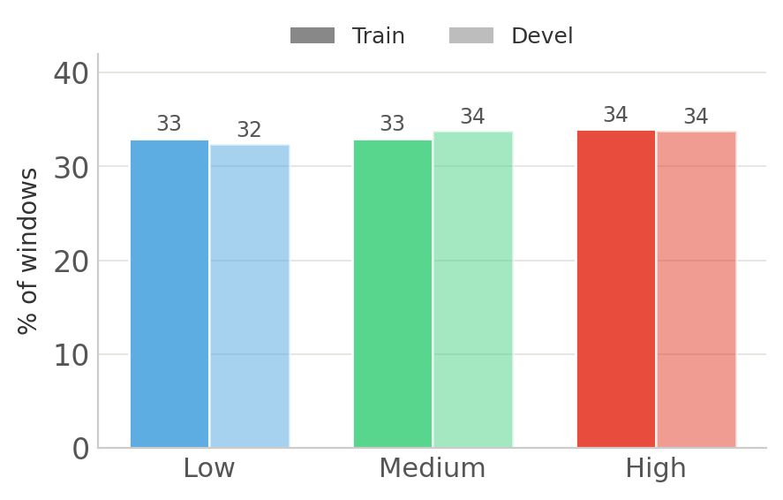
EDA – Key Findings
DATA QUALITY
< 2%
windows |z| > 3 (outliers)
0
missing values
All |r| ≤ 0.12 → arousal is multivariate
No single signal predicts it on its own
Label range −0.75 to +0.94; test labels withheld
KS test: train ≈ devel distribution

Slide 7
Output Dataset schema
Identifiers (4)
subject_id · window_id · start/end_timestamp
Raw features (9)
BPM/ECG/resp × mean/median/mode
Normalised features (9)
same columns, _norm suffix (Z-score)
Labels (3)
label_mean / median / mode
Classes (3)
class_mean / median / mode
4,105
Train
1,413
Devel
1,408
Test

Slide 8
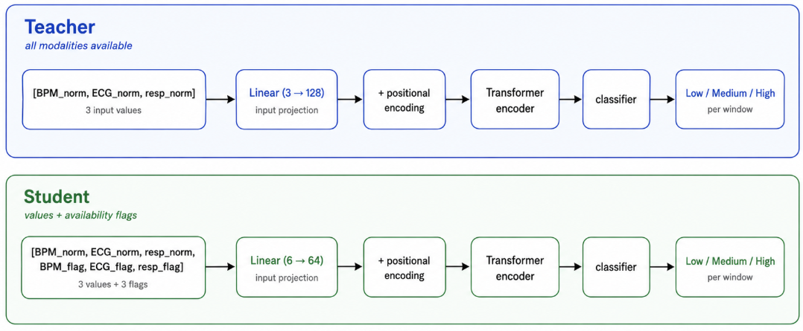
Input Representation
Generated with GenAI

Slide 9
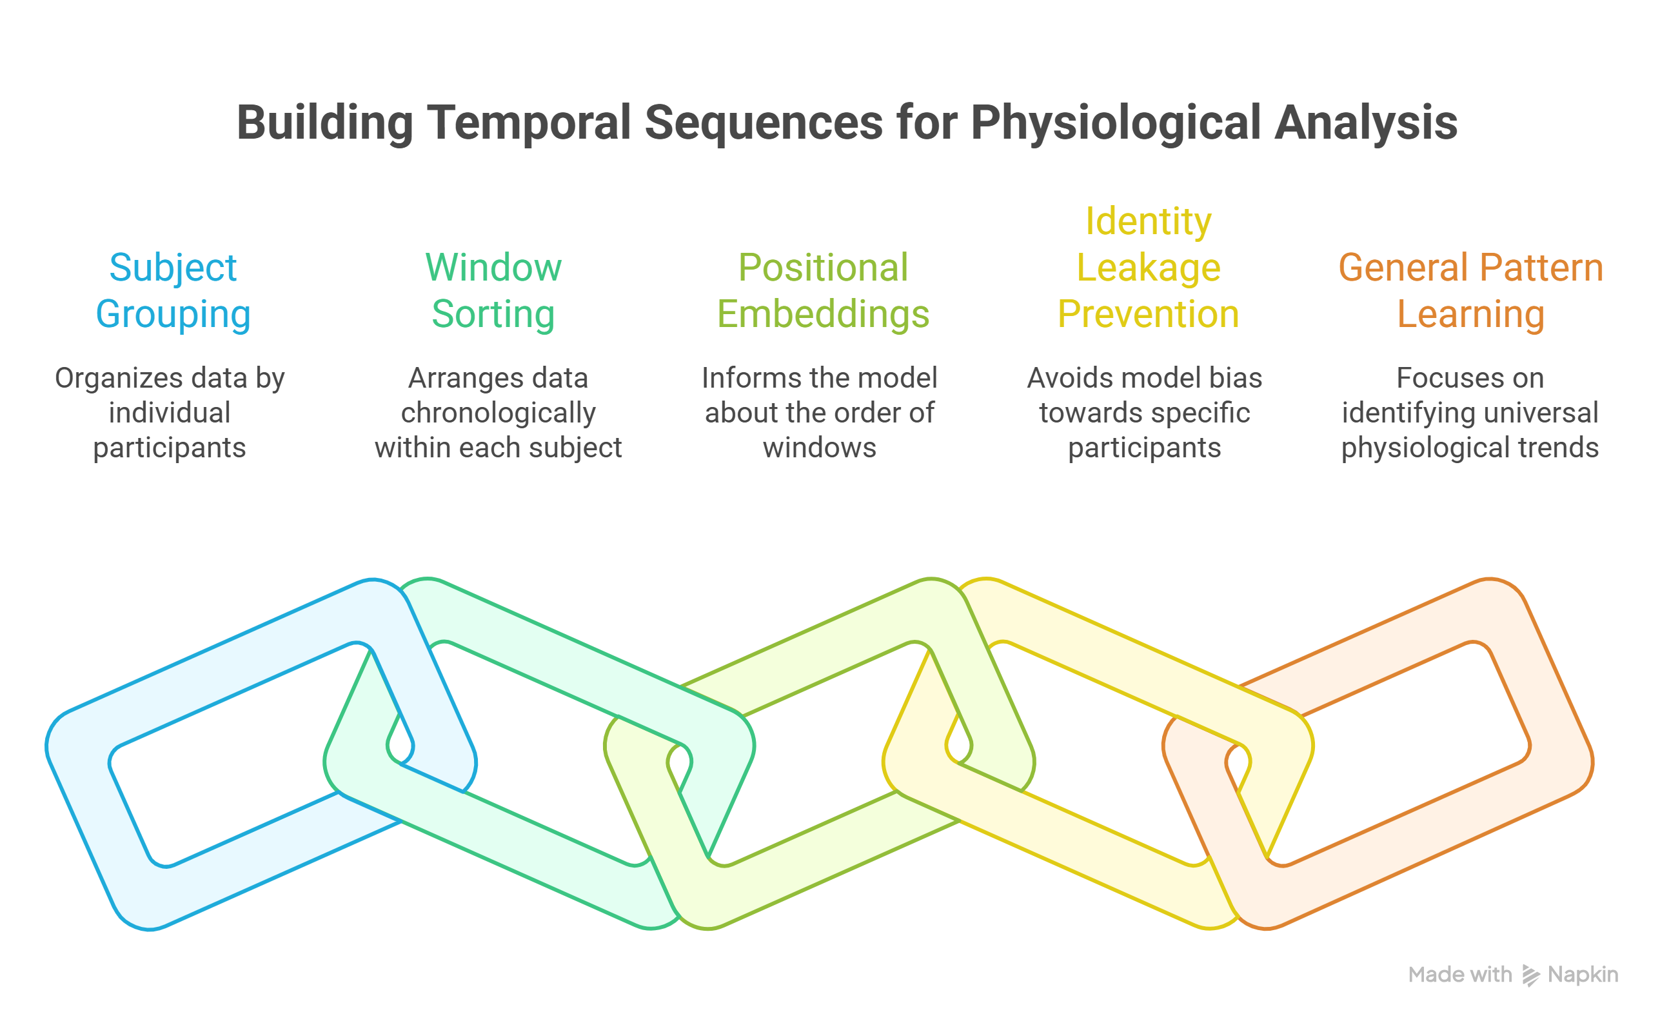

Slide 10
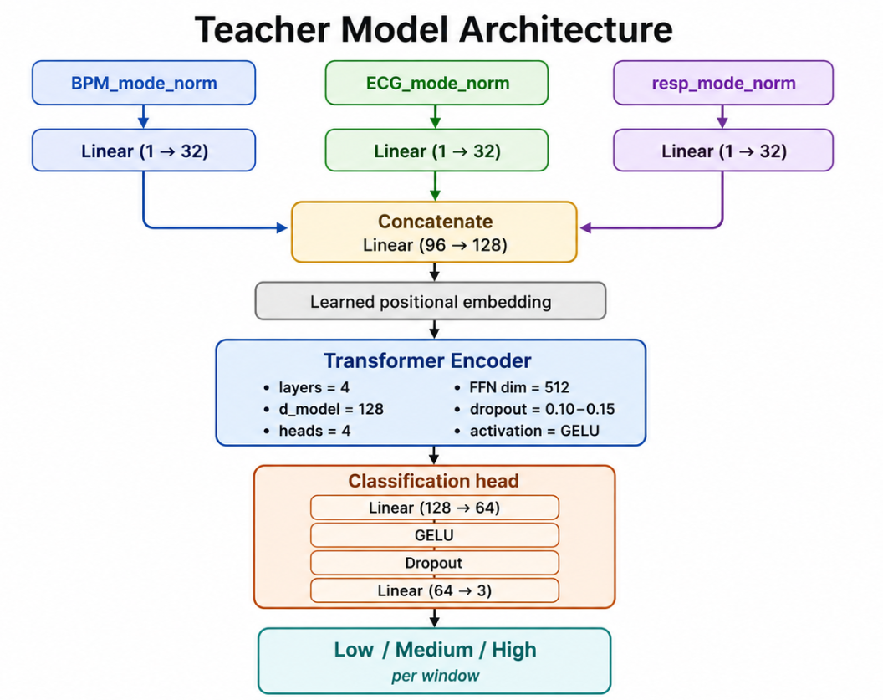
Teacher Model
Full modality transformer model: BPM, ECG and Resp
Physiological meaning dependent on temporal context. E.g. a single BPM value may not mean much alone, but a rising or falling trend over time can be informative.
The teacher learns both temporal patterns across windows and cross-modal relationships between signals
Generated with GenAI

Slide 11
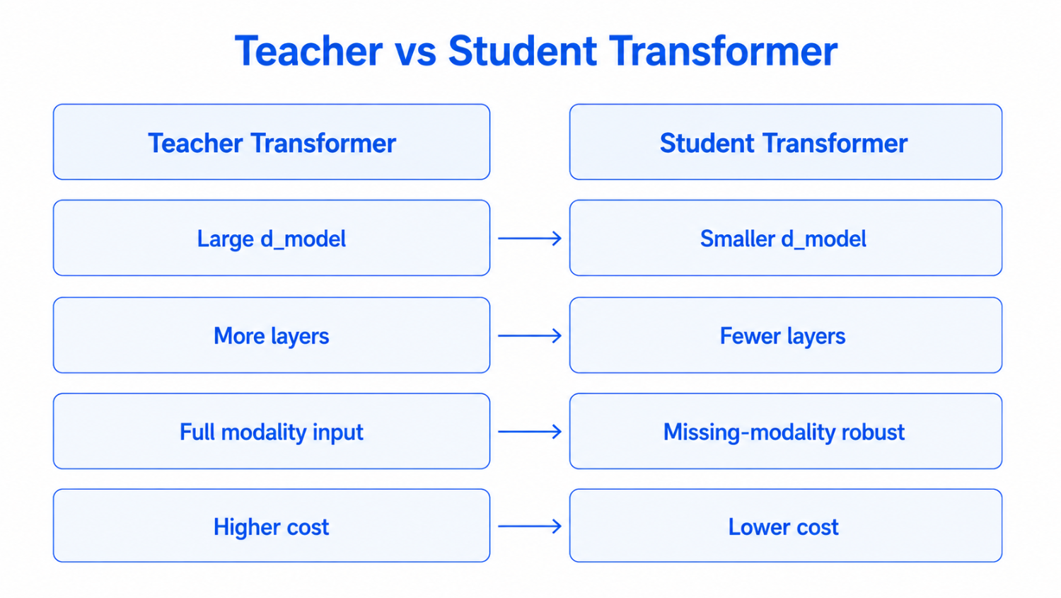
Student Model
Same general architecture pattern as the teacher, but smaller
Makes teacher-student alignment easier during distillation.
The student is designed to be more efficient while still trying to retain most of the teacher’s performance.
Generated with GenAI

Slide 12
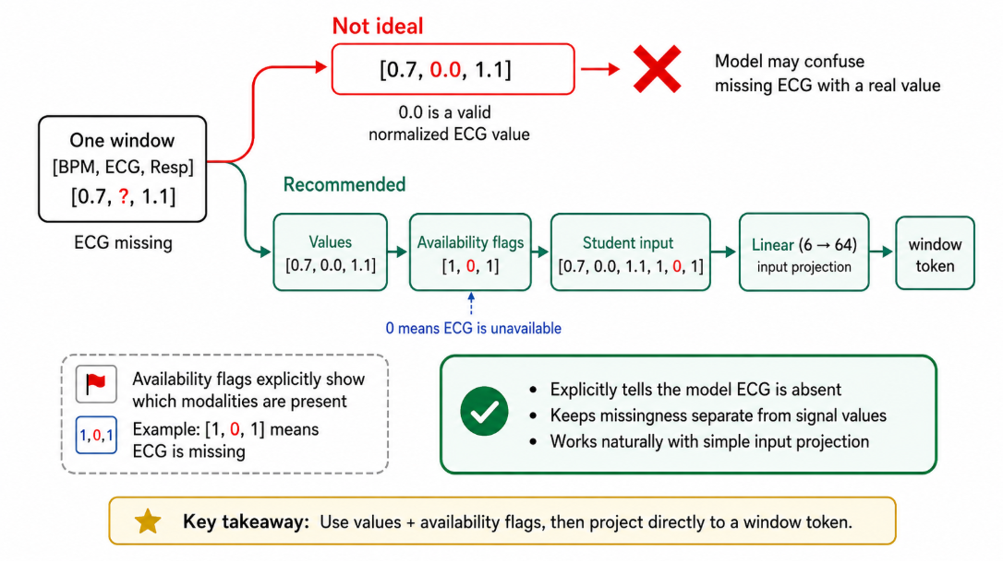
Missing Modality Student Training
To simulate real-world physiological sensing: different modality combinations.
Generated with GenAI

Slide 13
Knowledge Distillation - Setup
Knowledge transfer from teacher (larger model) to student (smaller model).
Using offline distillation and response based KD:
1. Train full-modality teacher.
2. Train smaller student using:
- hard labels
- teacher soft logits/probabilities

Slide 14
Knowledge Distillation – Algorithm choice
Hinton-style temperature scaled soft label distillation : using KL divergence between teacher and student softened probabilities.
Algorithm:
Train teacher, then freeze it.
Student receives full or masked modalities.
Compute: teacher logits and student logits.
Train student with: hard-label loss + soft-label distillation loss
Why?: classification task → KL over class probabilities

Slide 15
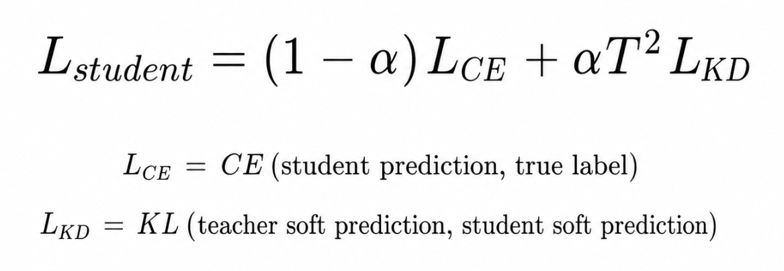
Loss function
Symbol | Meaning
Lstudent | Final loss used to train the student
CE | Cross-entropy loss: teaches the student the true label
y | True class label: Low, Medium, or High
KL | KL divergence: teaches the student to match the teacher
alpha | Controls balance between true labels and teacher guidance
T | Temperature: softens teacher/student probabilities
T^2 | Keeps the KD loss scale stable when using temperature

Slide 16
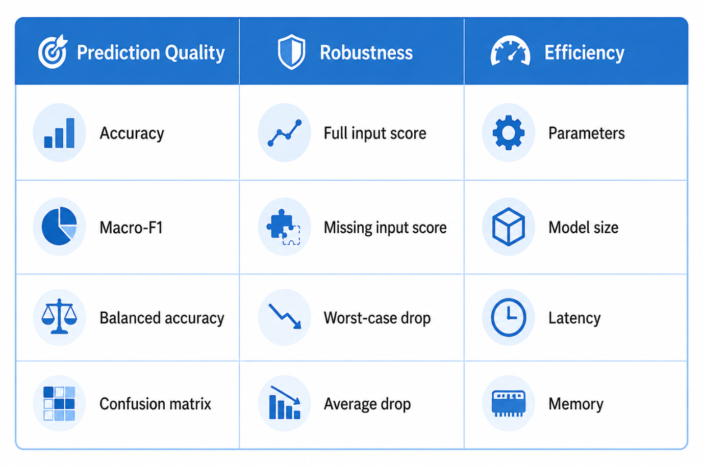
Evaluation Plan
Generated with GenAI

